Slide 1
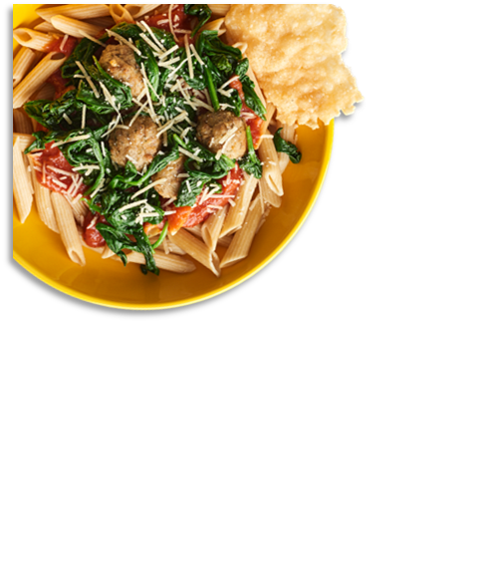
District Logo
April 2025
CAM MIDDLE SCHOOL
MENU
Limited Time Offer:
Turkey & Apple Melt
8-10 April
 | MON |  | TUES |  | WED |  | THURS |  | FRI
 |  | 1 |  | 2 |  | 3 |  | 4
7 |  | 8 |  | 9 |  | 10 |  | 11
14 |  | 15 |  | 16 |  | 17 |  | 18
21 |  | 22 |  | 23 |  | 24 |  | 25
28 |  | 29 |  | 30
Cherry Frudel
A. Beef Nachos
B. Chicken Nuggets
C. Pepperoni Pizza
Homemade Breakfast Pizza
A. Country Popcorn Chicken Potato Bowl
B. Mc. Ribb
C. Sausage Pizza
Egg & Cheese Bagel Melt
A. Pancakes w/ Cheese Omelet
B. Chicken Tenders
C. BBQ Chicken Pizza
Lumberjack
A. Cheesy Baked Penne Pasta
B. Corn Dog
C. Variety Pizza
Egg & Cheese English Muffin Melt
A. Bosco Sticks
B. Popcorn Chicken
C. Cheese Pizza
Country Sausage Gravy w/ Biscuit
Twin Soft Beef Tacos
B. Chili
C. Pepperoni Pizza
LTO: Samples
Homemade Breakfast Pizza
A. BBQ Rib
B. Chicken Tenders
C. Sausage Pizza
LTO:Turkey & Apple Melt
Sausage & Cheese Bagel Melt
A. Donut w/ Egg Patty
B. Pulled Pork SDW
C. Meat Lovers Pizza
LTO:Turkey & Apple Melt
Ham, Egg & Cheese Muffin
A. Mac & Cheese
B. Grilled Cheese
C. Variety Pizza
NATIONAL GRILLED CHEESE DAY
Offered Daily @ Breakfast
Fresh Fruit
1% White Milk
Chocolate Milk
100% Fruit Juice
Assorted Cereals w/ Graham Crackers
Chicken & Cheese English Muffin Melt
A. Salisbury Steak
B. Corn Dog
C. Cheese Pizza
Chicken & Maple Syrup Waffle SDW
A. Bosco Sticks w/ Pizza Dunking Sauce
B. Cheese Dog
C. Pepperoni Pizza
Homemade Breakfast Pizza
A. Spaghetti w/ Beef Sauce
B. Chicken Nuggets
C. Sausage Pizza
Offered Daily @ Lunch
1% White Milk
Chocolate Milk
Cheese & Pepperoni Pizza
Cheeseburger
Chicken Sandwich
Spicy Chicken Sandwich
Sun Butter & Jelly Sandwich
Salad
Tots or Fries
Egg & Cheese English Muffin Melt
A. Beef Nachos
B. Pulled Pork SDW
C. Pepperoni Pizza
Homemade Breakfast Pizza
A. Horseshoe
B. Popcorn Chicken
C. Sausage Pizza
Sausage & Cheese English Muffin Melt
A. Lumberjack
B. McRibb
C. Meat Lovers Pizza
Blueberry Mini Waffle
A. Buffalo Ranch Chicken Basket
B. Corn Dog
C. Variety Pizza
Egg & Cheese Muffin Melt
A. BBQ Chicken Flatbread
B. Bosco Sticks
C. Cheese Pizza
Cheesy Sausage & Egg Burrito
A. Twin Soft Tacos
B. Chicken Tenders
C. Pepperoni Pizza
Homemade Breakfast Pizza
A. Chicken & Noodles
B. Corn Dog
C. Sausage Pizza
* Bread is offered with Salads
Menus are subject to change.
All Lunches Must Include Choice of:
Fruits and/or
Vegetable
And May Include:
1% Low-Fat White or Chocolate Milk
This institution is an equal opportunity provider.

